Slide 1


Fashion MNIST Dataset
Haya Safieddine
Reine Beyh
Kamal Dbouk

Slide 2
What is it?
Collection of pictures similar to MNIST that have images of clothing.
Consists of grayscale images of 10 different types of clothing items.
Each image is a 28x28 pixel grayscale images.
Why do we use it?
Benchmarking Models: Researchers and practitioners to compare the performance of different models.
Real-World Relevance: It can be integrated into online retail.
Educational purposes: It is an accessible and simple image classification problem.

Slide 3
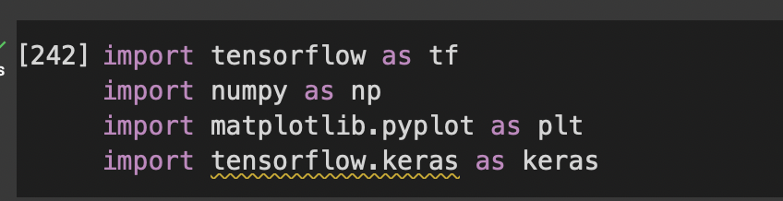
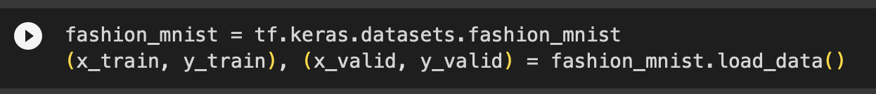
Import the following datasets:
tenserflow (tf)
numpy (np)
mathplotlib.pyplot (plt)
tenserflow.keras (keras)
Load Fashion-MNIST dataset

Slide 4
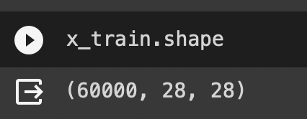
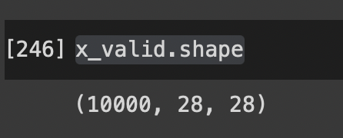
Exploring the Dataset
x_train.shape:
There are 60,000 images in the training set.
Each image is 28x28 pixels.
x_valid.shape:
There are 10,000 images in the testing set.
Each image is 28x28 pixels.

Slide 5
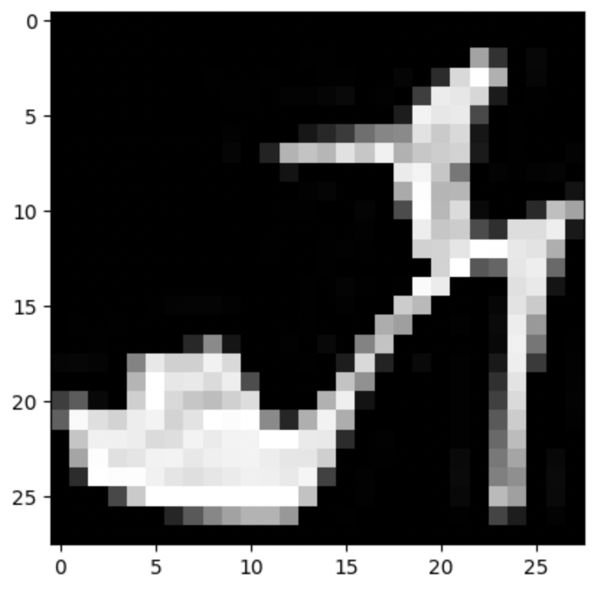
The images are mapped to a label where the labels are split into:
T-shirt
Trousers
Pullover
Dress
Coat
Sandal
Shirt
Sneaker
Bag
Boot

Slide 6
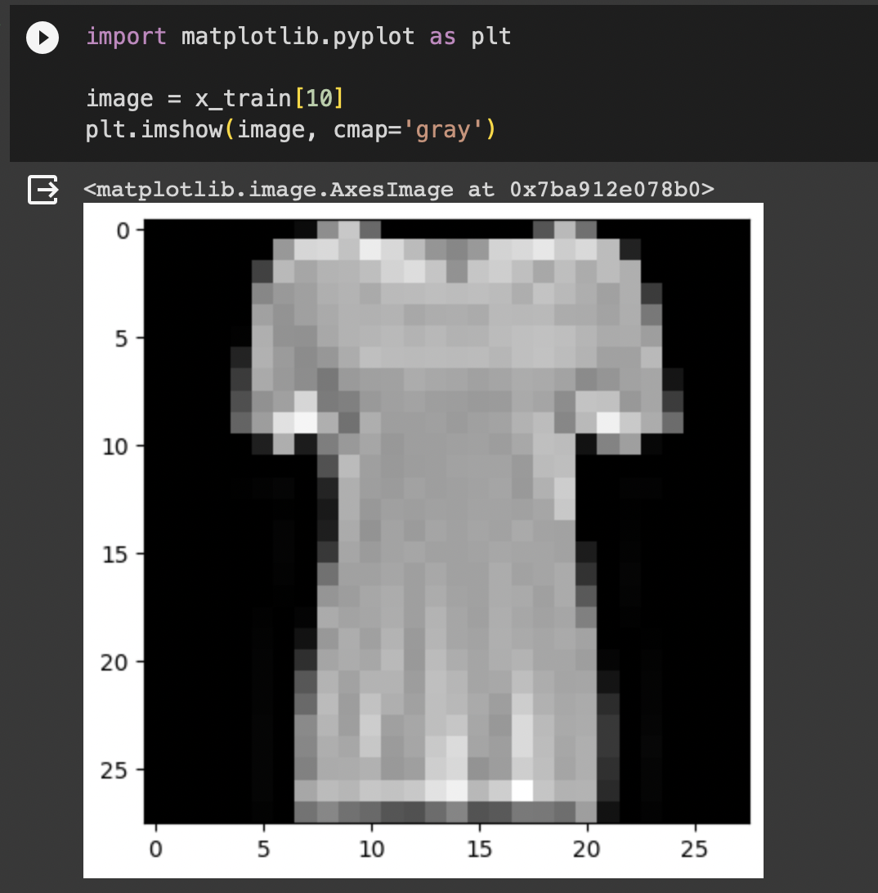
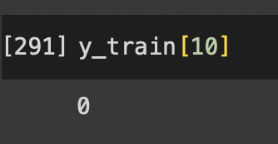
How does it work?
Each integer placed in the training image corresponds to an article of clothing.
The label at the same integer will output the integer from the class_names array.
class_names = ['T-shirt', 'Trousers', 'Pullover’, 'Dress', 'Coat’, 'Sandal', 'Shirt', 'Sneaker', 'Bag', 'Boot']

Slide 7
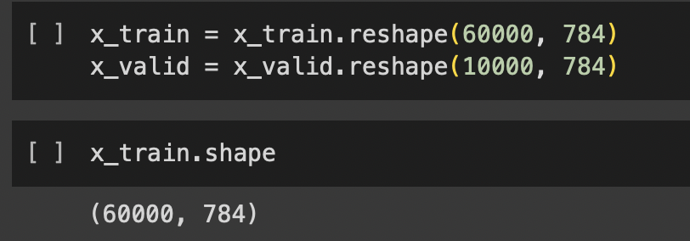
Preparing the data for training…
Flatten image data
Reshape into a 1D array containing 784 pixel values each.
Normalize the Data
Normalize the data by dividing by 255. The values are now [0.0-1.0].
Categorize the Labels:
Converting the single integer labels to a one-hot encoded format.

Slide 8
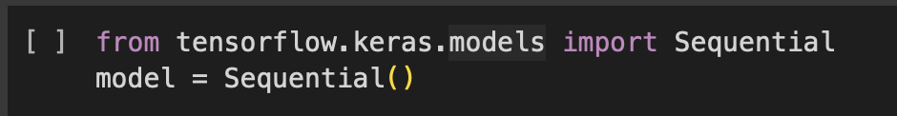
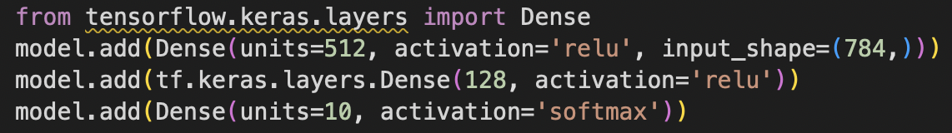
Creating the model
Initialize the model.
Create three layers:
Input layer of 512 neurons, relu activation function (reduce non-linearity) and an input shape of 784 as we previously flattened the data.
Hidden layer of 128 neurons and the relu activation function.
Output layer of 10 neurons (equivalent to 10 classes and the softmax activation function (each neurons output represents the probability of the corresponding class).

Slide 9
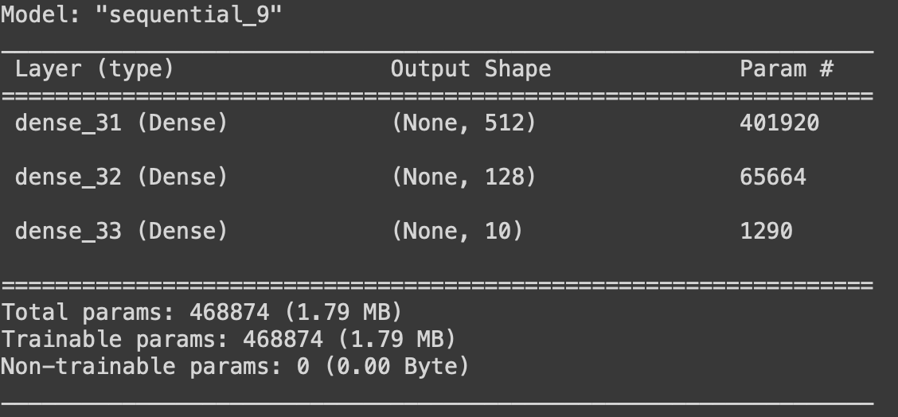
Model Summary

Slide 10
Compiling the Model
Optimizer
Adaptive Moment Estimation (adam): Adjusts the parameters of a neural network to improve the accuracy and speed.
Loss
Categorical Cross Entropy: This is a multi-class classification problem where each example belongs to one class.
Metric
Accuracy: Has the model calculate the accuracy as a metric during training and evaluation. Each epoch will report the accuracy during training.

Slide 11
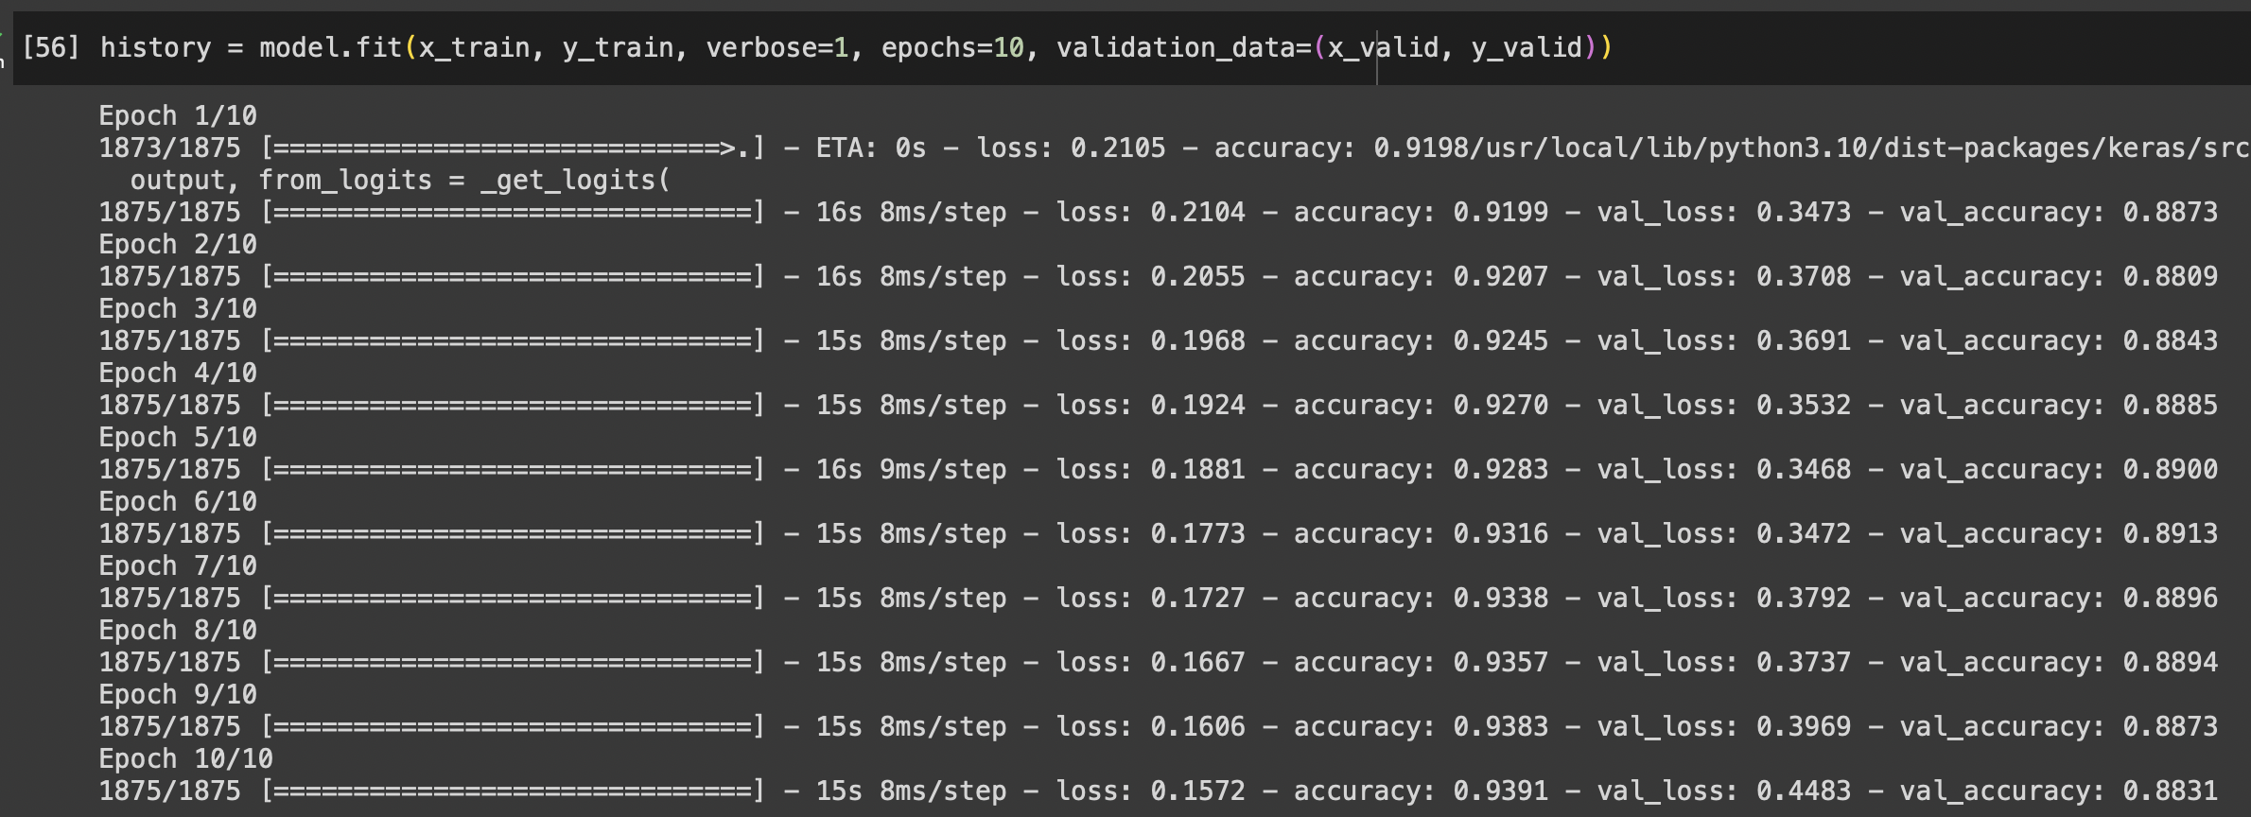
Training the model

Slide 12
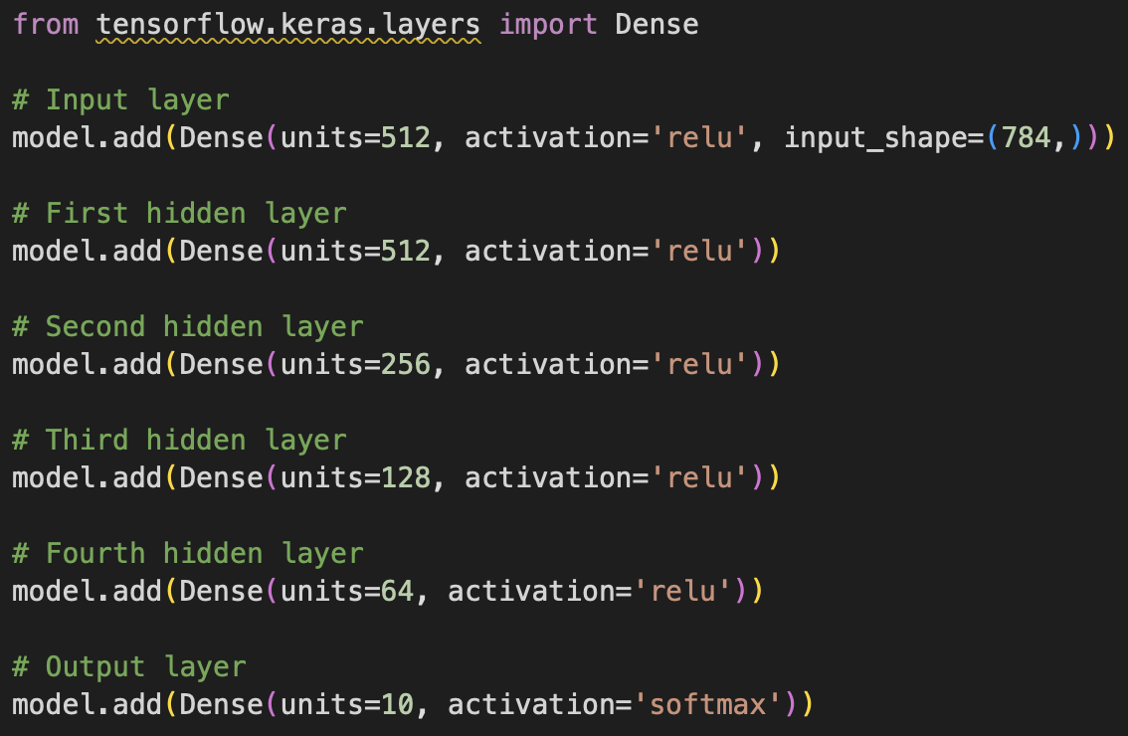
Try again…
We attempt the same thing but with 4 hidden layers this time.
When fitting the model, we notice the accuracy has decreased by an average of 3%.
This decrease is due to overfitting where the model has “memorized” the data and is unable to perform on new data.

Slide 13
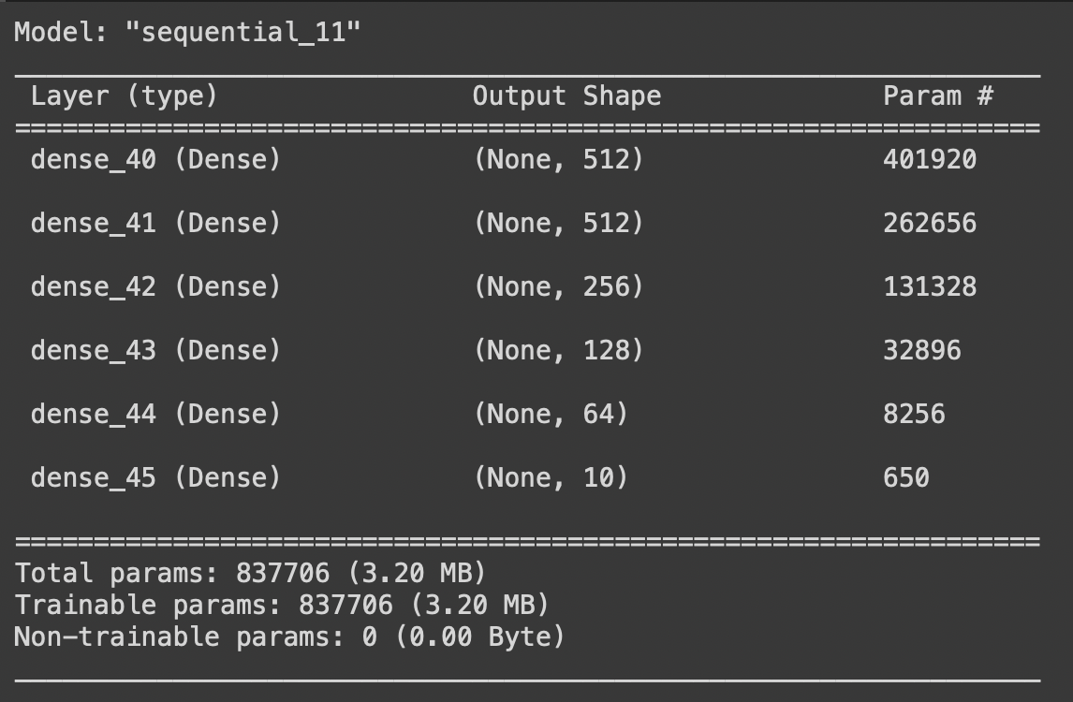
Model Summary

Slide 14
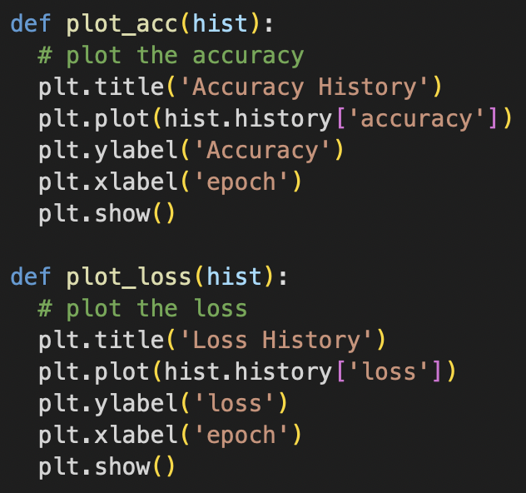
Plotting the History
Plot the Loss
How well the model is performing on the training data.
The goal is to minimize the loss during training.
Plot the Accuracy
The proportion of correctly classified samples in the training set.

Slide 15
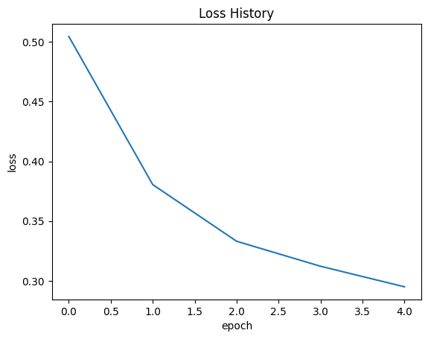
Loss
DECREASING…
The parameters are adjusted to make the model more accurate during training. Optimizer and loss function work together by iteratively updating the model's parameters based on the slope of the loss with respect to those parameters.

Slide 16
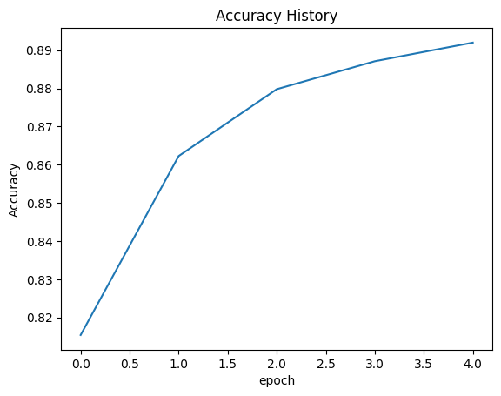
Accuracy
INCREASING…
As the model learns from the data, it is becoming better at making predictions. The model is improving its ability to classify examples.

Slide 17
What does this mean?
Decrease in loss and Increase in accuracy are interconnected.
When loss decreases, model is minimizing difference between the prediction and the correct label. This leads to an increase in accuracy (more correct samples).
The predictions made by the model in the beginning of training had a higher loss and in return, less accuracy. As training continues, classification improves and there is a decrease in loss.
Loss
Accuracy

Slide 18
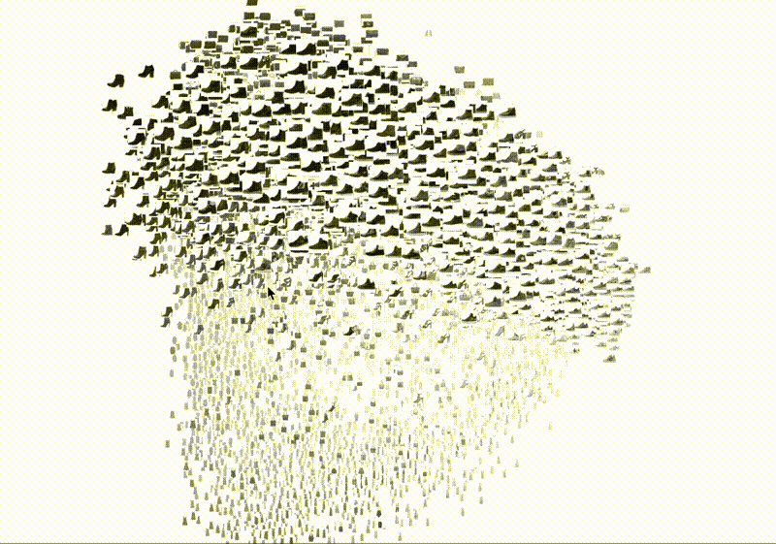
Thank you!

